Slide 1


DSC530 Final Project
By Jaimie Cain

Slide 2
Research Questions
Does an increase in activity lead to a decrease in weight?
2. Does an increase in activity lead to more sleep?
4. How much daily/weekly activity is needed to see a change in sleep?
3. How much daily/weekly activity is needed to see a change in weight?

Slide 3
What variables do you think have an impact on your question
Total Steps
Calories
Total Minutes Asleep
Weight Pounds
BMI
There are three separate datasets that I used ID and Date to join the variables across files

Slide 4
Describe what the 5 variables mean in the dataset
Total Steps - marks the activity of the participant
Calories - is how much energy was used during the activity
Total Minutes Asleep - is the time measurement of sleep activity
Weight Pounds - standardized measurement for the weight of the participant
BMI - calculation based on the weight/height and age of the participants

Slide 5
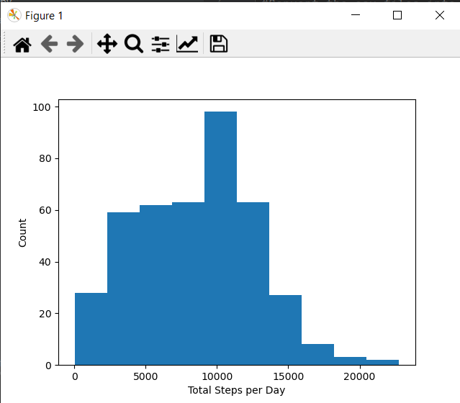
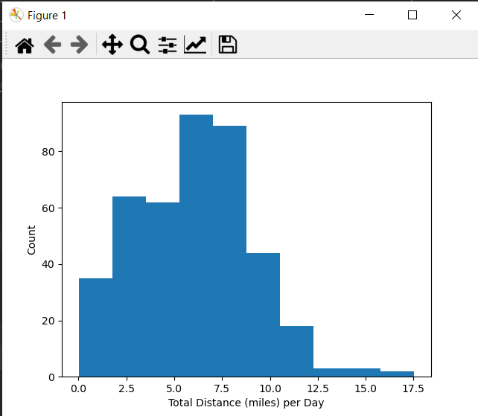
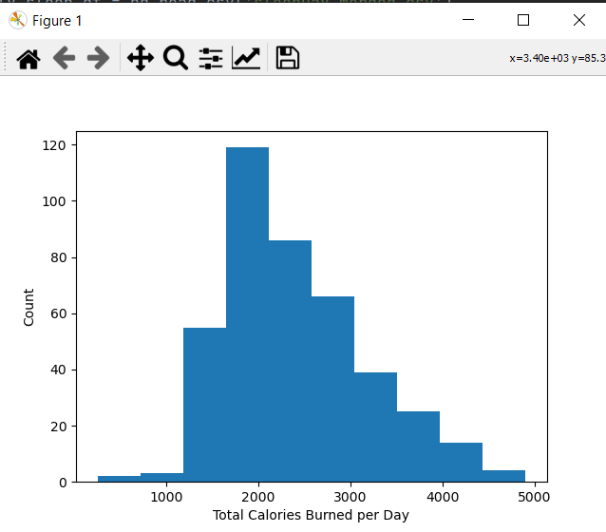
Histograms
Total Steps per Day
Total Distance per Day
Total Calories per Day
There is a large negative tail on this histogram showing that several of the days the Participant’s logged less than 10000 steps. This aligns with rest days and does not seem to skew the data.
Since distance is correlated with the Total Steps it would make sense that the Total Distance per Day is also negatively skewed to account for rest days.
This has a more positively skewed curve showing that the majority of Participants burned more than the expected 2000 calories per day. Alternate exercise methods may have been used that did not register on the distance/steps.

Slide 6
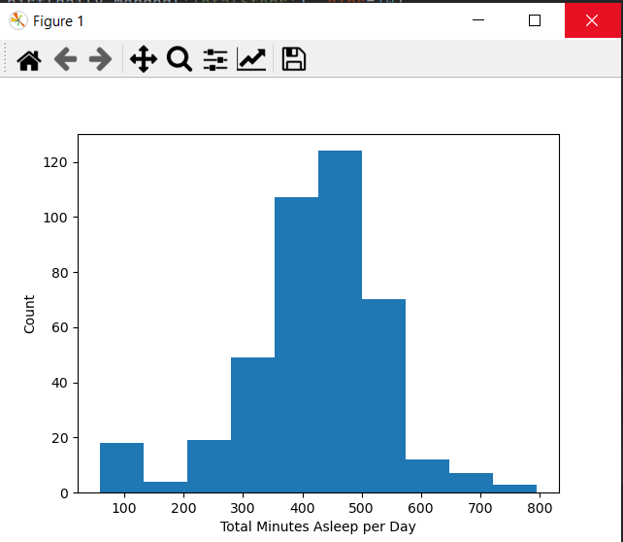
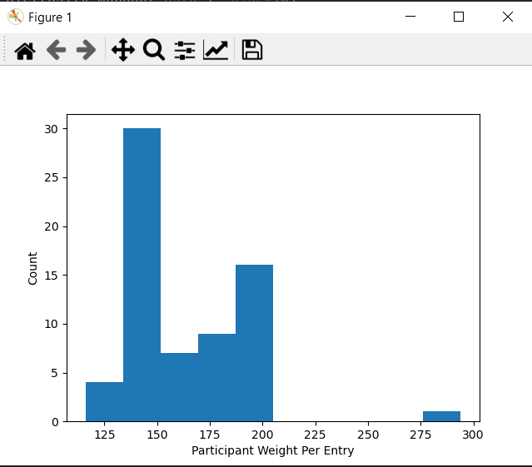
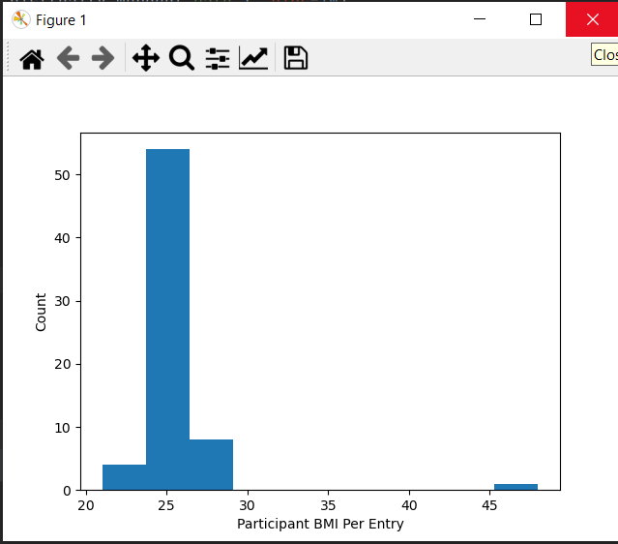
Histograms cont’d.
Total Minutes Asleep per Day
Participant’s Weight Per Entry
Participant’s BMI per Entry
This is a normal distribution curve showing the majority of the Participant’s got the expected 7-9 hours of sleep per night. There are a few outliers in the 1-2 hour range that are introducing a negative skew to the data.
There were a lot of missing values for the weight entry since it was not a daily measurement. Overall the weights were not normally distributed with a heavy concentration in the 130-150 lb range. There is a set of outliers in the 275 – 300 range.
The BMI closely aligns with the discrepancies seen with the weight entries as expected. The majority of measurements are in the expected range of 24-28. The outlier from the weight also was represented as the outlier in BMI at > 45.

Slide 7
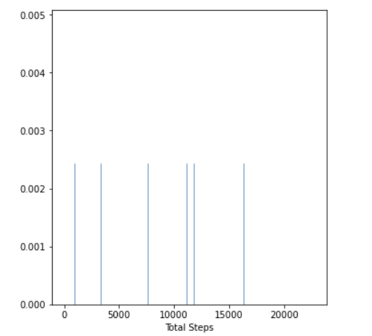
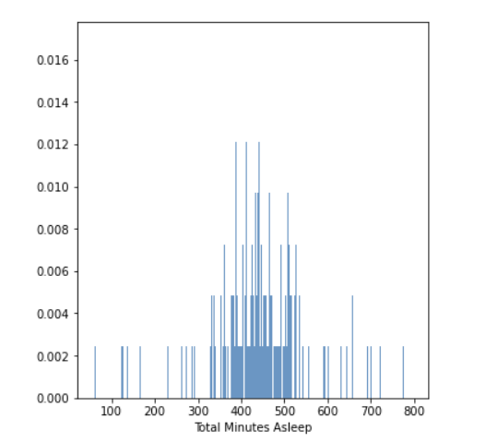
PMF Comparison of Total Steps (left) and Total Minutes Asleep (right)
Total Steps PMF
Total Minutes Asleep PMF

Slide 8
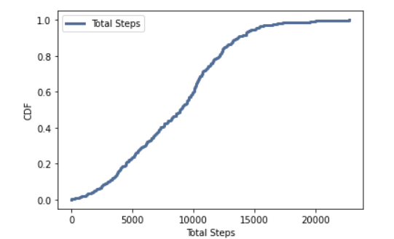
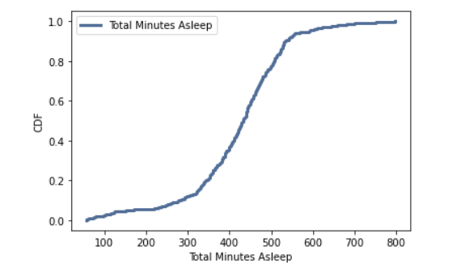
CDF Comparison of Total Steps (left) and Total Minutes Asleep (right)
Total Steps PMF
Total Minutes Asleep PMF

Slide 9
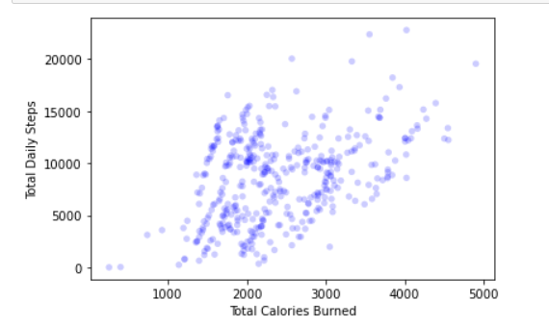
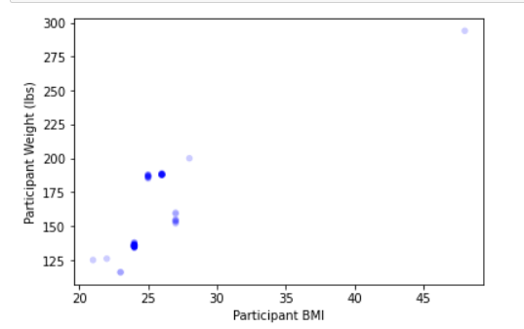
Scatterplot comparison of two variables
Steps vs Calories
Weight(lb) vs BMI

